Slide 1
Agenda
Anti Patterns
Anti Patterns
God Objects
Copy and Paste
Lava Flow
Boat Anchor

Slide 2
Anti Patterns
Anti-patterns are the opposite of software design Patterns.
Anti-patterns are the outcomes of bad practices, over-engineering and implementation of design patterns without having enough knowledge or not understanding the context of the problem.
Notes:
SOLID principles form the fundamental guidelines for building object-oriented applications.

Slide 3
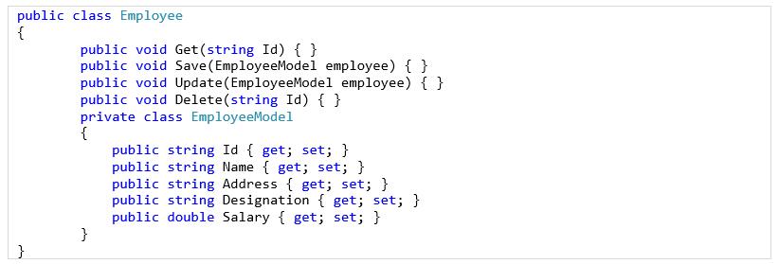
God Objects
An object that knows too much or does too much is called a God object.
God object is just the opposite of the Single responsibility Principle.
God objects are costly to maintain. If you change anything in a God object, you must test the whole object’s functionality.
Notes:
Separation of Concerns (SoC) also conveys a similar idea.

Slide 4

Copy and Paste
When you write your code, you take the help of Google, Stackoverflow or some articles to complete your code. This pattern is good if you are doing it to boost your development with a good understanding of it.
But it becomes an Anti-pattern when you do it with your own code. If you are doing copy and paste of your own code to multiple modules or places, then it is an Anti-pattern.
Move such code to a class and reuse that one.
Notes:
Separation of Concerns (SoC) also conveys a similar idea.

Slide 5

Lava Flow
The lava flow occurs when a code is working well but is not documented or difficult to change or understand.
This code exists in a system because it works.
Notes:
Separation of Concerns (SoC) also conveys a similar idea.

Slide 6

Boat Anchor
The Boat anchor occurs when a part of the code is kept in the system despite it is no longer in use.
This happens since developers believe that might need it in future. This belief seems always wrong.
Notes:
Separation of Concerns (SoC) also conveys a similar idea.

